Slide 1



Call center voice clustering
Indira college of engineering and management
Guide: Manisha Bharati
Rohan Salvi B150524282
Shubham Asabe B150524206
Sanket Shirse B15052429
Vipul Ahire B150524201

Slide 2
Problem Statement
To evaluate Customer Request To Service Call Center in Text Format for classify the Request into different categories;
New vehicle purchase
Test drive requests
Breakdown
Feedback
Insurance

Slide 3
Aim
Currently, call center agents interact with customers and try to facilitate and fulfill the customer needs. As part of the solution, we need to classify the customer Request in Text Format To Service Call Center into different categories of Request linked with automotive industry (i.e., new vehicle purchase enquiries, test drive request, breakdown assistance, roadside assistance, Insurance, Servicing etc.) for necessary action by the business.
We need to Customer Request in Text Format To Service Call Center for classify the Request into different categories listed below:
1. New vehicle purchase enquiries ( i.e., Enquiry on latest or future or existing product features, price, availability, closest showroom to drop in for purchase or exchange, etc.)
2. Test drive requests ( i.e., Request for booking test drives, follow up Request with customers to schedule the same, confirmation that test drive has been done as per schedule or with delayed schedule, etc.)
3. Breakdown ( i.e., Customer Send Request TO contact center to report vehicle break down and providing his location details for repair or breakdown assistance, Road assistance mechanic reaching out to customer and reaching location with preliminary input on vehicle condition )
4. Feedback ( Feedback collected post sales /service on vehicle delivery on customer sales/ service experience)

Slide 4
Complete objectives
9.Detecting the keywords which department they belong.
10.The data bank of specific department words will also generate and add new words automatically to its data bank.
11.Output of every user relating to the specific department will be shown on admin portal.
1.GUI User End Module
2.Database connection module -Record Store in DB module
3.OTP verify module
4.Login Authentication module
5.Voice to input module
6.Extract token from Sentence module
7.Special Symbol remove module
8.Remove stop words, Keep keywords module

Slide 5
Motivation
In today's world , many customer send request to call center there is a lot of waiting for thousands of people at a time ,to make this quick and efficient we are going to work on this project
This was the problem statement given by TCS in their hackathon.

Slide 6
Literature survey
Sr no.​ | Paper Title​ | Idea/Algorithm description​ | Problem found​
​1 | Multiclass Digital Audio Segmentation with MFCC​ Features using Naive Bayes and SVM Classifiers(2019)(ASYU)​ | ​Detects Silence, Speech and Music | Detects only audio segments​
2 | Analysis of Detected Silent Segments in Call​ Center Recordings(2019)(IDAP)​ | Adaptive amplitude Threshold, Entropy and variance, RNN​ | Solution for audio processing​
3​ | Feature Selection for Anomaly Detection in Call Center Data(2019) (ELECO)​ | O-SVM, IF and a MG​ | Did not cluster the data
4​ | Text clustering algorithm based on deep​ representation learning(2018 )(The Journal of Engineering)​ | K-means, VSM (TF-TDF),CNN)​ | Did not deal with audio data set​
5​ | Artificial Neural Networks in Customer Segmentation(2019)(SIU)​ | MLP​​ | More into visualization, Don’t deal with audio data​​
Notes:
Support Vector Machine/
Mel Frequency Cepstral Coefficients feature extraction
Isolation forests Multivariate Gaussian
multilayer perceptron

Slide 7
Literature survey
Sr no.​ | Paper Title​ | Idea/Algorithm description​ | Problem found​
​6 | Mobile Phone Clustering From Speech Recordings Using Deep Representation and Spectral Clustering(2018) | MFCC,SVM
7 | A Hybrid Approach for Mobile Phone Clustering With Speech Recordings(2019) | MFCCs, MPC | Speech recording over mobile phones
8 | Machine Learning-based Silence Detection in Call Center Telephone Conversations(2019) | Naive Bayes, MFCC, K means
9 | Classification Techniques for Automatic Speech Recognition (ASR) Algorithms used with Real Time Speech Translation(2017) | DTW,MFCC,HMM | Works on small dataset
10 | A Review on Emotion Recognition using Speech(2017) | MFCC,RNN,KNN,LPCC | Rises problem with Different size of audio
Notes:
Probabilistic yin
Support Vector Machine/
Mel Frequency Cepstral Coefficients feature extraction
Isolation forests Multivariate Gaussian
multilayer perceptron

Slide 8
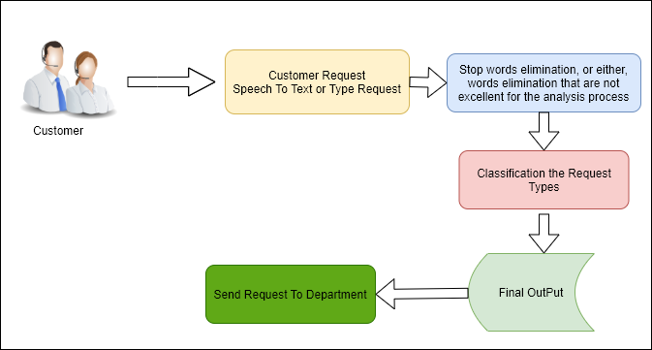
Pre-Processing Approach

Slide 9
One-class svm
One-class SVM is an unsupervised algorithm that learns a decision function for novelty detection: classifying new data as similar or different to the training set.
It should separate the two classes A and B very well so that the function defined by:
f(x) = a.x + b is positive if and only if x A f(x) 0 if and only if x E B
It exists as far away as possible from all the observations (robustness of the model). Given that the distance from an observation x to the hyperplane is a.x + b/a. The width of the space between observations is 2/ a. It is called margin and it should be largest. Hyperplane depends on support points called the closest points. Generalization capacity of SVM increases as the number of support points decreases.
Notes:
This is done by multiplying two metrics:
Tf no. of occurrence of I in j
Df bumber of documents in
- Easy to compute - You have some basic metric to extract the most descriptive terms in a document - You can easily compute the similarity between 2 documents using it
TF-IDF is based on the bag-of-words (BoW) model, therefore it does not capture position in text, semantics, co-occurrences in different documents, etc

Slide 10
Tools and technology used
Java
JDK
XAMPP
JDK
APACHE
MYSQL
OPERATING SYSTEM | WINDOWS XP/7/10
Development Framework | Java Framework 1.8 JDK
Programming Language | Java 8.1
Database | MySQL 5.5
IDE | Eclipse

Slide 11
DFD Level 0
System
Input
Output

Slide 12
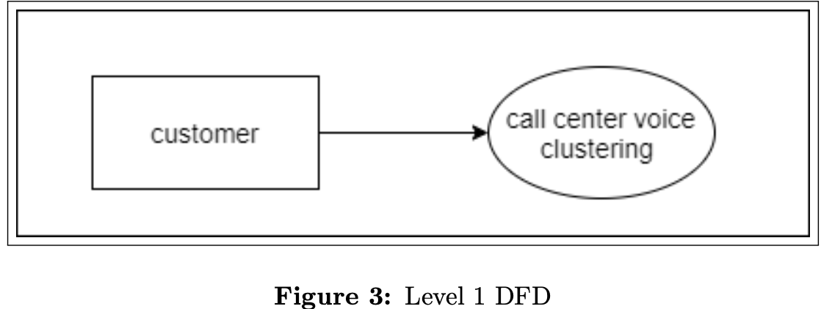
DFD level 1

Slide 13
DFD Level 2
Request speech to text or type request
Stop words elimination
Customer
Classify request types
Final output
Send request to department

Slide 14
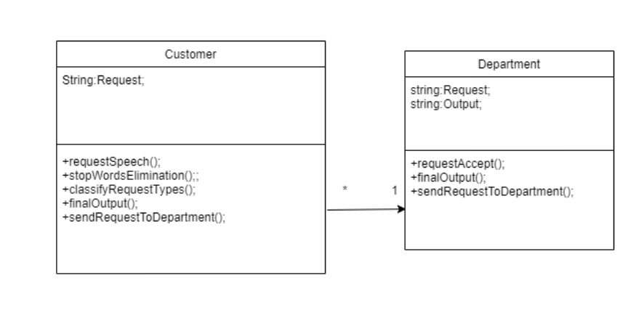
uml
Class diagram

Slide 15
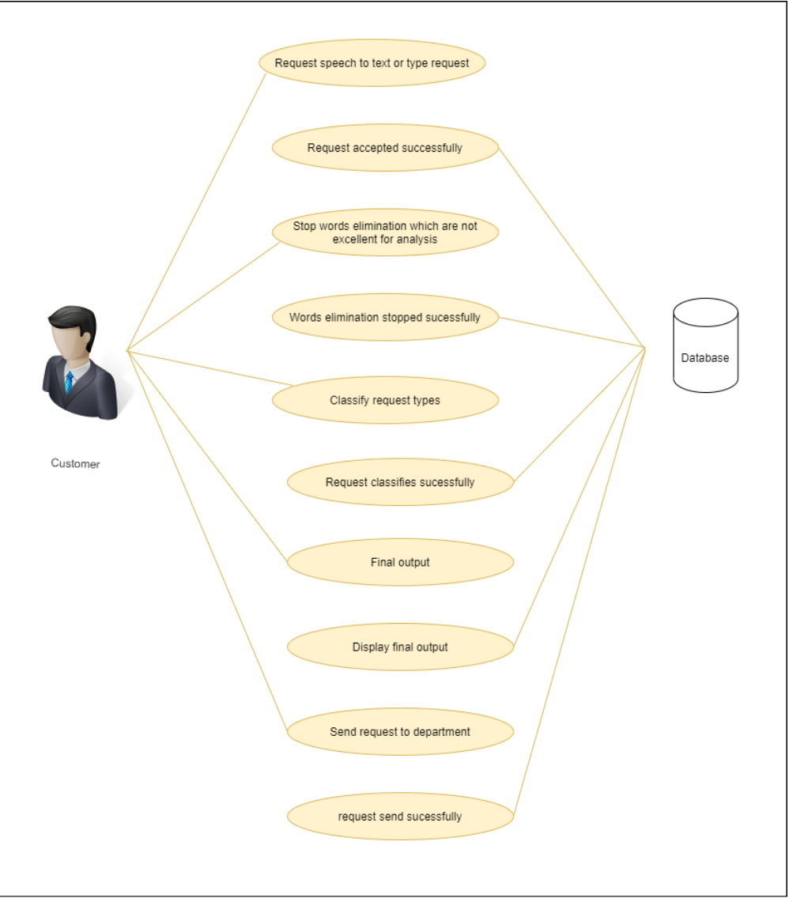
uml
Use case diagram

Slide 16
uml
Customer
activity diagram
Requested speech to text or type request
Stop words elimination that are not excellent for analysis
Classify the request types
Final output
Send request to department

Slide 17
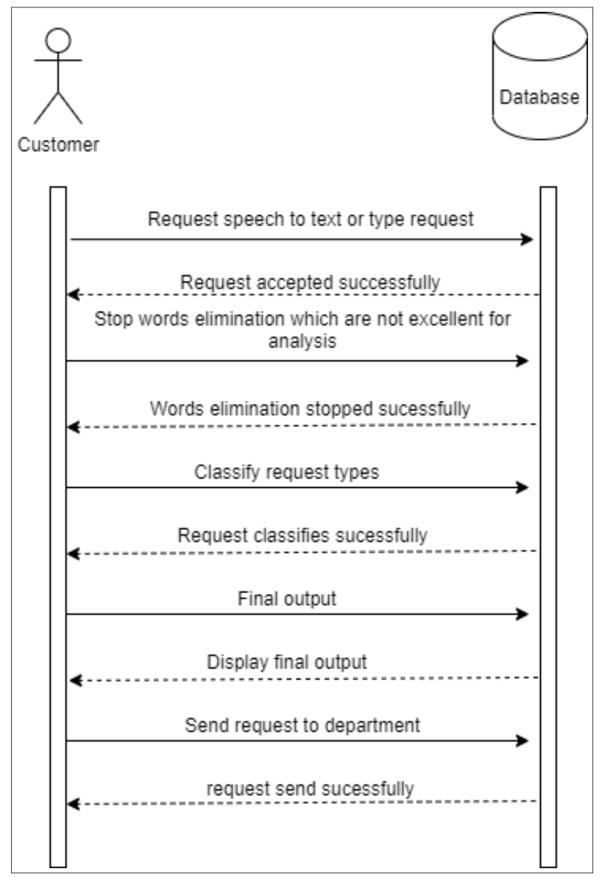
uml
Sequence diagram

Slide 18
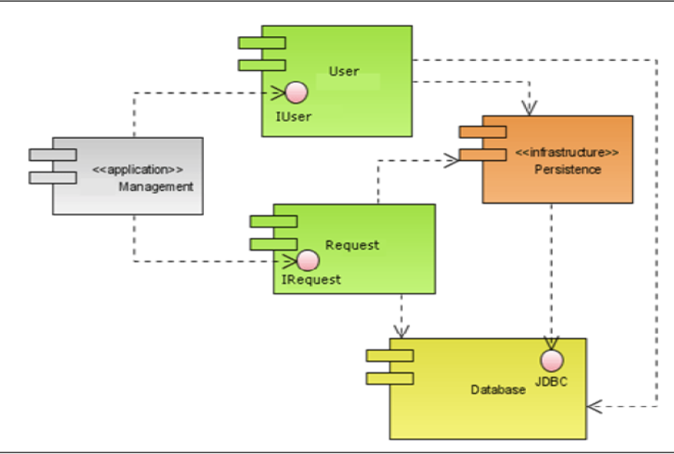
uml
Component diagram

Slide 19
Timeline

Slide 20
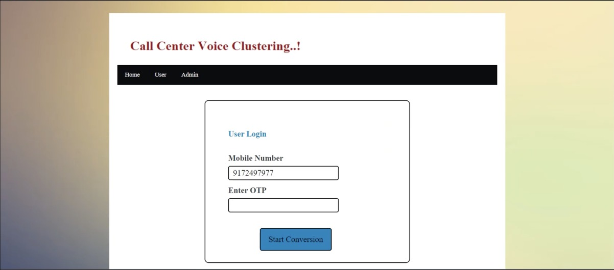
Outputs

Slide 21
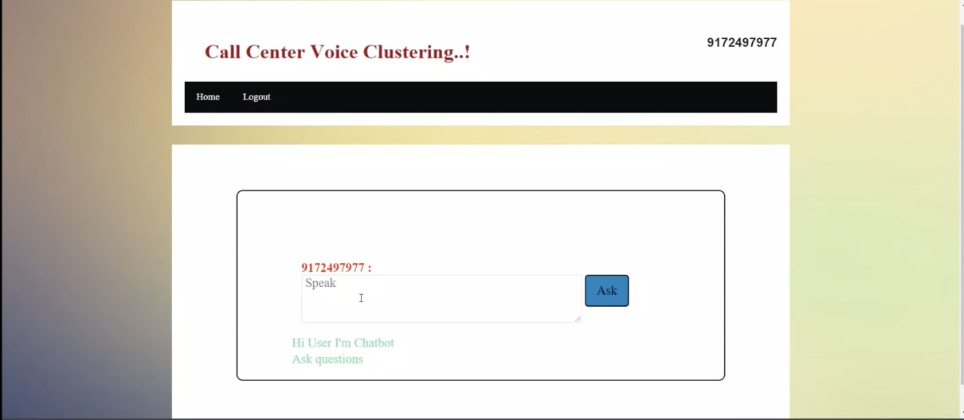
Output

Slide 22
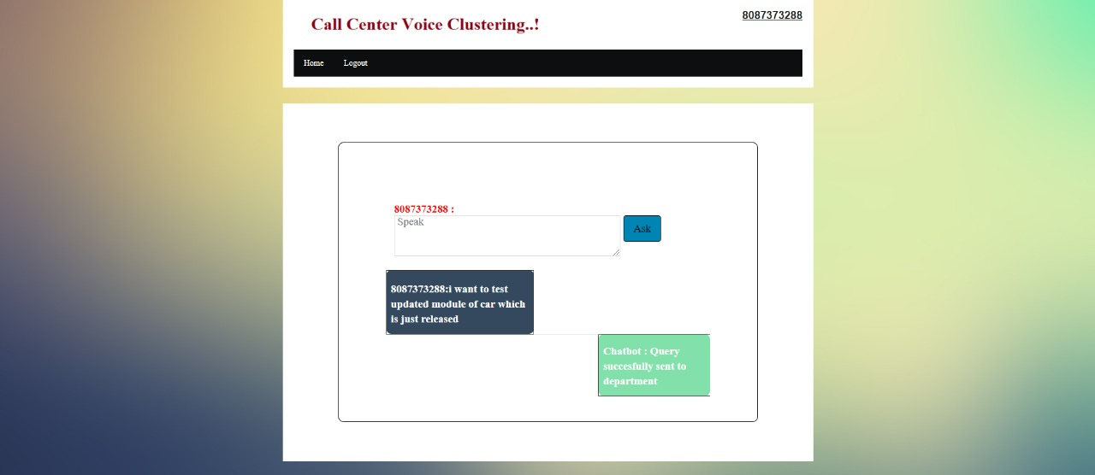
output

Slide 23
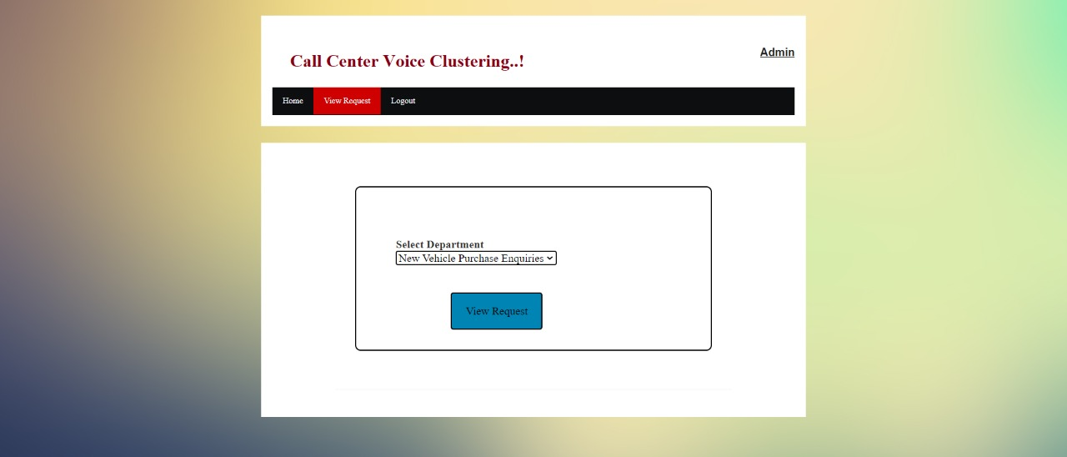
output

Slide 24
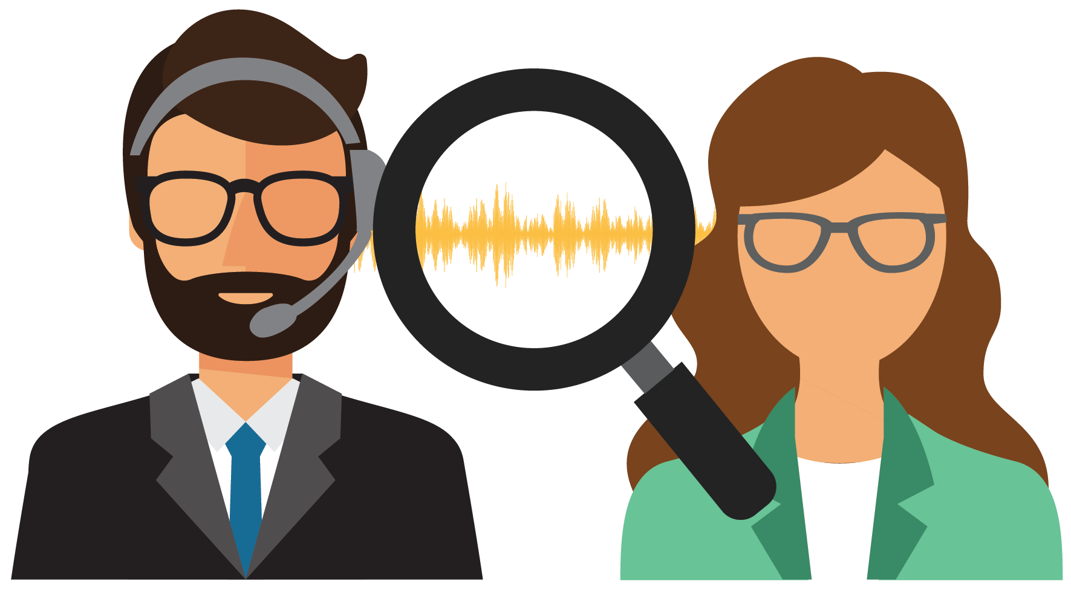
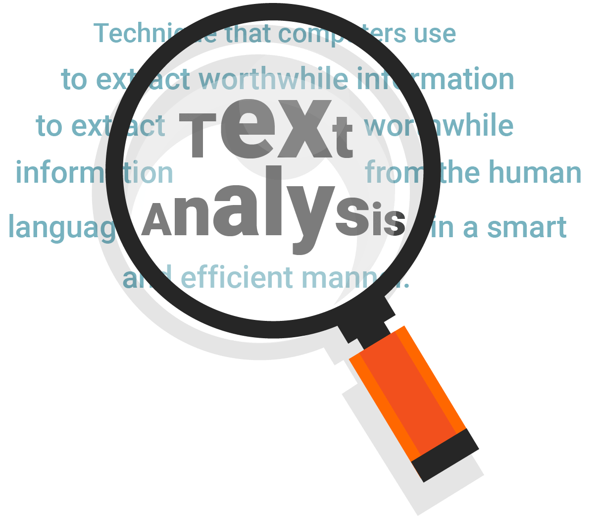
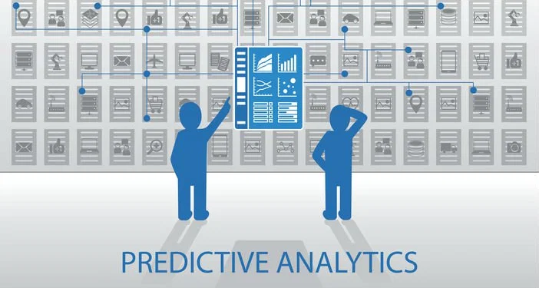
Future applications
Call Center Speech Analytics
Speech Analytics is a fairly new and relatively rare field, but one that many early adopters are finding significant success with.
2. Call Center Text Analytics
Text analytics can review and monitor not only the messages sent to customers, but also the message they are sending to the company. This is vital in seeing any potential issues through the customer lens.
3. Predictive Analytics
The modern predictive analysis engine is an invaluable tool in the call center environment.

Slide 25
Conclusion
So, we have completed the desired output needed although there can be many more modifications that can be made that can improve the working and overall performance of the project.
In accordance with the obtained results, it must be stressed that the sample of data, as well as the activities carried through the pre- processing step and clustering process are of fundamental importance to the knowledge extraction.

Slide 26
Thank You

